Slide 2
THE DISCIPLES RELATIONSHIP:
TO HIMSELF
An Athlete
A Soldier
TO HIS LORD
The Potter and the Clay
The Vine and the Branches
A Child of God
TO HIS BRETHREN
A Member of the Body
“My Brother’s Keeper”
A Servant
TO THE WORLD
Strangers & Pilgrims
Salt & Light
An Apologist
Fishers of Men

Slide 3
LESSON 6: A Child of God The Disciple’s Security
But as many as received Him, to them He gave the right to become children of God, even to those who believe in His name, (John 1:12)

Slide 4
The Disciple as a Child of God
Luke 11:2
And He said to them, "When you pray, say: 'Father, hallowed be Your name. Your kingdom come.
John 1:12-13
(12) But as many as received Him, to them He gave the right to become children of God, even to those who believe in His name,(13) who were born, not of blood nor of the will of the flesh nor of the will of man, but of God.
Rom 8:12-17, 1 John 5:10-11

Slide 5
The Disciple as a Child of God
How does a child become part of a family?
Born into it
Adopted
Rom 8:15
Gal 4:5
so that He might redeem those who were under the Law, that we might receive the adoption as sons.
Ephesians 1:5
He predestined us to adoption as sons through Jesus Christ to Himself, according to the kind intention of His will,

Slide 6
The Disciple as a Child of God
As a child of God, there are Blessings and Responsibilities.

Slide 7
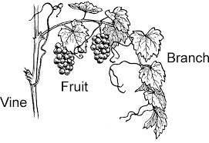
The Disciples Dependence
John 15:1-17
Christ is the Vine
Disciples are Branches
The Father is the Vinedresser

Slide 8
The Disciples Dependence
Abide
John 14:23
To Stay
To Remain
Jesus answered and said to him, "If anyone loves Me, he will keep My word; and My Father will love him, and We will come to him and make Our abode with him.

Slide 9
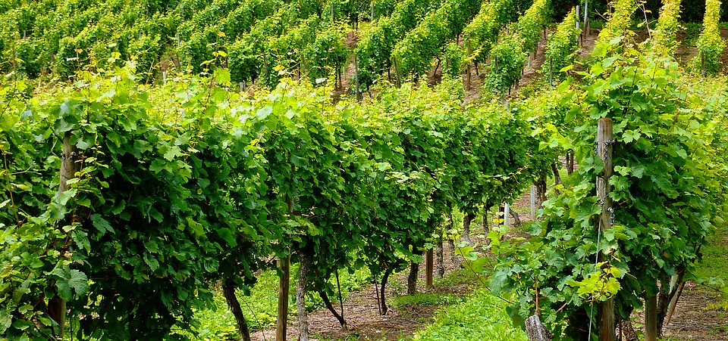
The Disciples Dependence
How does the branch remain in the vine?
If it stays attached, what does it receive?
What if it is detached?
It stays attached!
Nutrition, Support
Withers, Dries up, Dies
Dependence

Slide 10
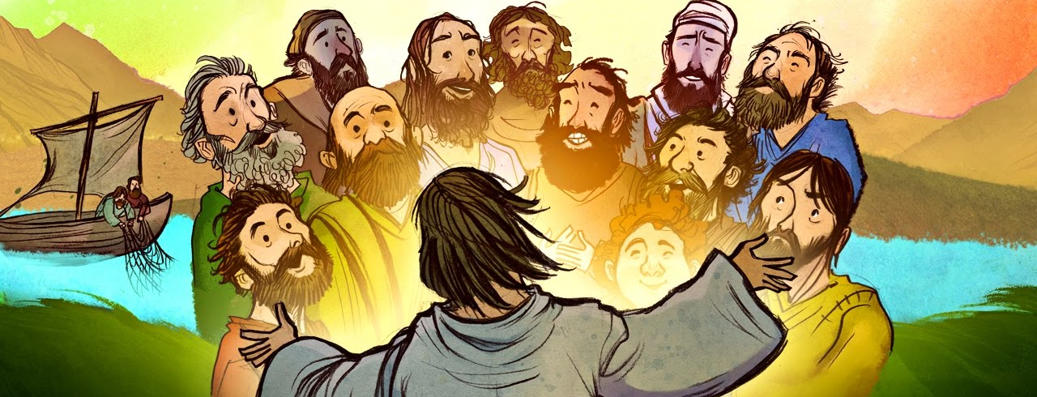
The Disciples Dependence
How does a disciple remain in Christ?
If he stays attached, what does it receive?
What if he is detached?
He stays attached!
Spiritual Nutrition, Support
Withers, Dries up, Dies
Dependence

Slide 11
The Disciples Dependence
How do disciples remain in Christ?
John 8:31
1 John 2:5
1 John 3:24
So Jesus was saying to those Jews who had believed Him, "If you continue in My word, then you are truly disciples of Mine;
…but whoever keeps His word, in him the love of God has truly been perfected. By this we know that we are in Him
The one who keeps His commandments abides in Him, and He in him. We know by this that He abides in us, by the Spirit whom He has given us.

Slide 12
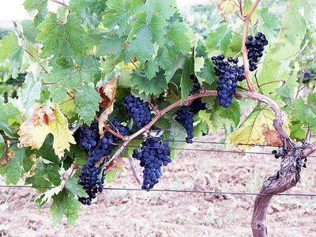
The Disciples Dependence
We will be like Vine
We will bear fruit
We will be pruned
We will remain connected
Our prayers will be answered
We will glorify God

Slide 13
The Disciples Dependence
We will be like Vine
James 3:12
Luke 6:40
John 13:14-17, 1 John 2:2-3
Can a fig tree, my brethren, produce olives, or a vine produce figs? Nor can salt water produce fresh.
A pupil is not above his teacher; but everyone, after he has been fully trained, will be like his teacher.

Slide 14
The Disciples Dependence
We will be like Vine
We will bear fruit
Gal 5:22 - Fruit of the Spirit
Matt 25:14-30 - Talents
Eph 2:10, Tit 3:14 - Good Works
Rom 1:13 - Converting the lost
Heb 13:15 - Praise to God
What is Fruit?
Results
Investment pays off
Fruit of your labors

Slide 15
The Disciples Dependence
We will be like Vine
We will bear fruit
We will be pruned
Examples of Pruning in the Scriptures?
Peter – Walking on water, Rooster
Paul – Trials
Discipline – Heb 12:10-11
Trials – James 1:2-4, Rom 5:3-4
Abiding in the Vine
+ Bearing Fruit
Pruning
Bearing more Fruit
All the while depending on the Vine

Slide 16
The Disciples Dependence
Are you Abiding, Remaining, Staying in Him or are you just visiting here and there?
How will you be more like the Vine? Got to know the Vine first.
How much time will you spend in His word, meditating on His word?
Do you depend on Christ in the pruning? Are you letting the pruning make you grow?

